Slide 1

JARVIS
Design Thinking
Isaura Cabrera
Tony Zhao

Slide 2

Table of Contents
Brief Introduction
Recap
Decoding HTML
Tokenization
GMAIL API Demo
Conclusion

Slide 3

Introduction
JARVIS is a function that will provide an easier guidance when viewing emails. Instead of having to manually program an email rule, JARVIS can load certain emails that have a high importance. JARVIS will be classifying the emails in categories based on the key words listed in the Subject & Body of the email. JARVIS will be assisting both the Innovation Center & Students.

Slide 4
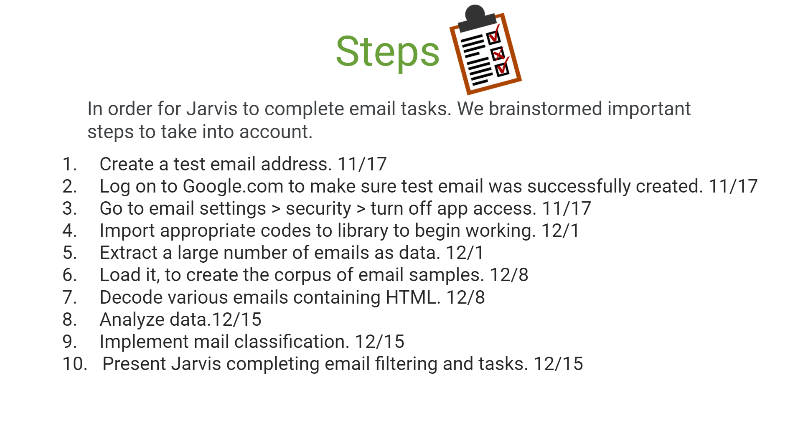

Recap

Slide 5
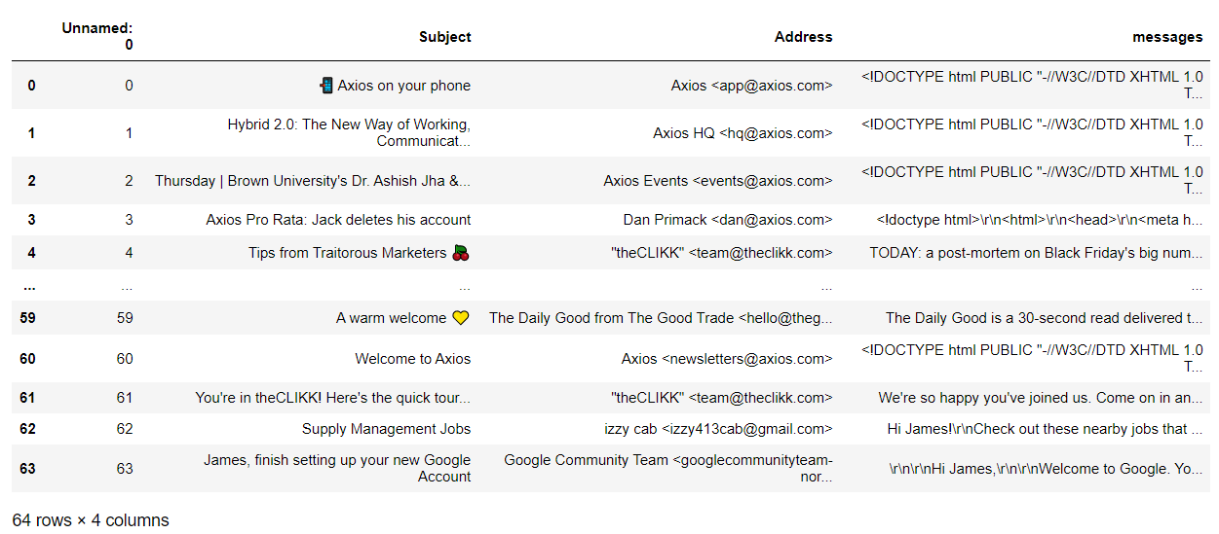
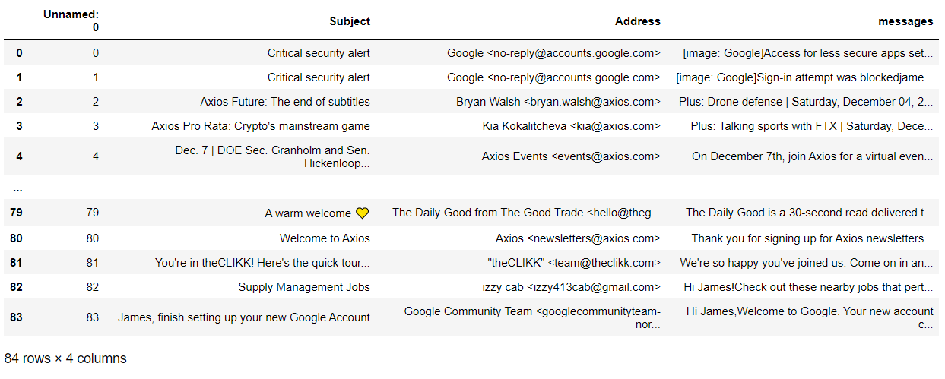
Decoding HTML
On the left corpus that was created, you’ll notice that under the message column. The messages are unreadable. The full email body is not currently displaying correctly. It’s being displayed as a HTML, using random codes and including numbers. Using UTF-8 & BeautifulSoup, it helped us accomplish our decoding process. We are now able to see the entire message.

Slide 6
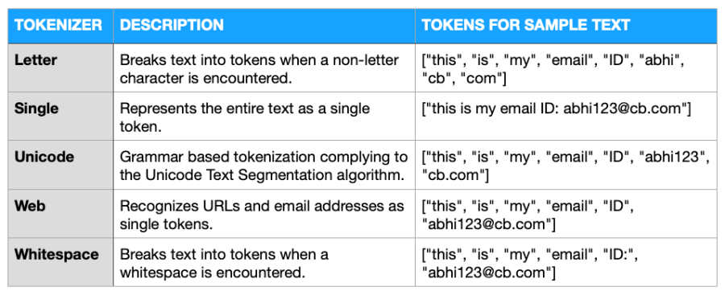
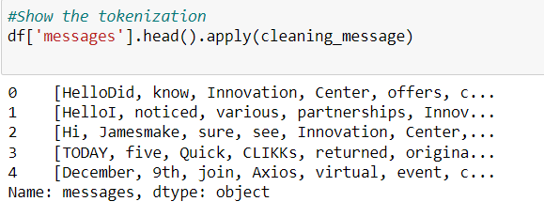
Tokenization
In order to filter out certain emails, we have performed tokenization to successfully classify. Jarvis will be identifying keywords and will know what emails are relevant to the user.

Slide 7

Demo
To Assist in today’s Demo, we will be using GMAIL API to do so. In this demo, the User is given the ability on how many emails they wish to load.

Slide 8
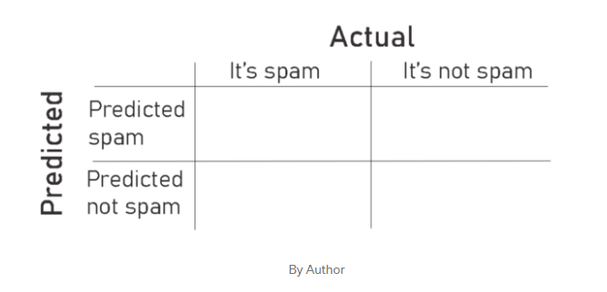
Conclusion
To give a better illustration on how Jarvis will be classifying emails. We will be describing its role using the Confusion Matrix below:
Jarvis will carefully connect
Keywords, recognize them
& successfully add them
To appropriate folders,
or consider them as Spam.
Websites used:
Moataz, Khalid. “What Is the Confusion Matrix and How to Use It.” Medium, Analytics Vidhya, 4 Sept. 2020, https://medium.com/analytics-vidhya/what-is-the-confusion-matrix-and-how-to-use-it-6dd63fab33ed.
(TP)
(FN)
# of emails that are considered spam & are classified as them
# of emails that are of importance & classified wrongly as spam
# of emails that are spam but are classified as if they are not.
# of emails that are not spam, classified correctly & are not spam
(FP)
(TN)

